Slide 1
4th International Workshop on
Dark Matter, Dark Energy and Matter-Antimatter Asymmetry
Spaceborne Gravitational Waves Detection – Tianqin Mission
Hsien-Chi Yeh
Tianqin Research Center for Gravitational Physics
Sun Yat-sen University
30th December, 2016

Slide 2
Outlines
TianQin mission concept
Key technologies
Development strategy

Slide 3
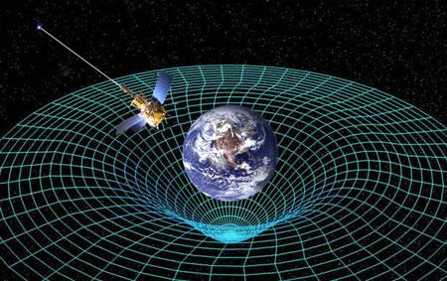
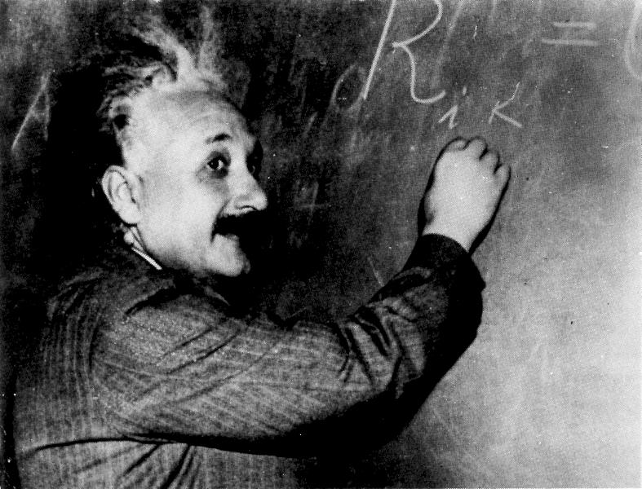


What is gravitational waves？
Basic concepts of GR and GW
Matter determines structure of spacetime;
Spacetime determines motion of matter.
Characteristics of GW:
change in distance
speed of light
two polarizations

Slide 4
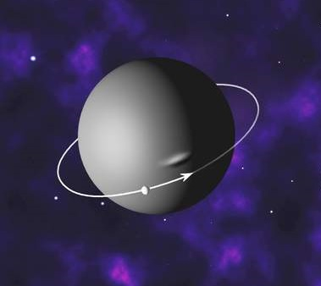
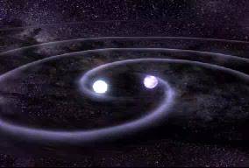
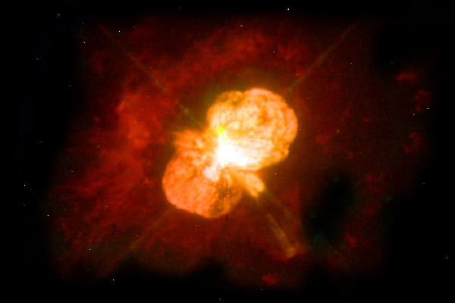
Meanings of GW detection
Fundamental physics：
Test theories of gravity in the strong field regime.
Gravitational-wave astronomy：
Provide a new tool to explore black holes, dark matters, early universe and evolution of universe.

Slide 5

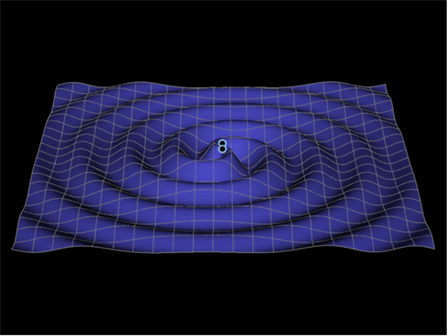
Why is GW detection so tough？
Two 1-solar-mass stars with inter-distance of 1AU, detecting far from 1 light-year
Distance change of 1Å over 1AU !
Difficulties：
direction？
distance？
polarization？
wave shape？
large intrinsic noise!
overlapping signals!

Slide 6
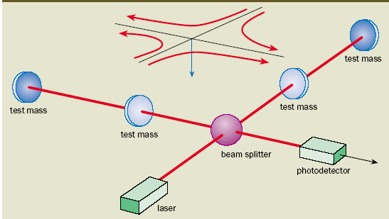
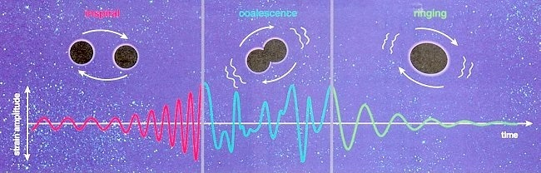
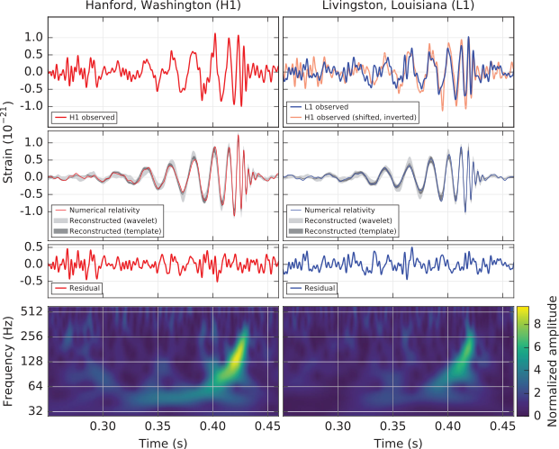
LIGO GW Antenna
Merging of 2 black holes
1915：General Relativity
1916：prediction of GW
1962：interferometer antenna
1984：initiating LIGO
2002：LIGO started exp.
2010：upgrade aLIGO
2016：GW detected

Slide 7
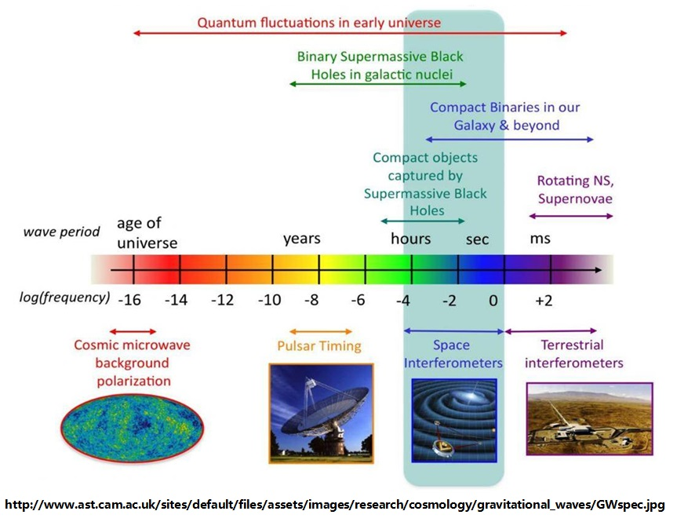
Why we need space GW detections?
GW spectrum and detectors
Significances：
abuntant types of sources
    Binary systems（white dwarfs、neutron stars、black holes）、merging of massive black holes、primordial GW
stable sources
    Compact binaries
strongest sources
    Binary super-massive black holes

Slide 8
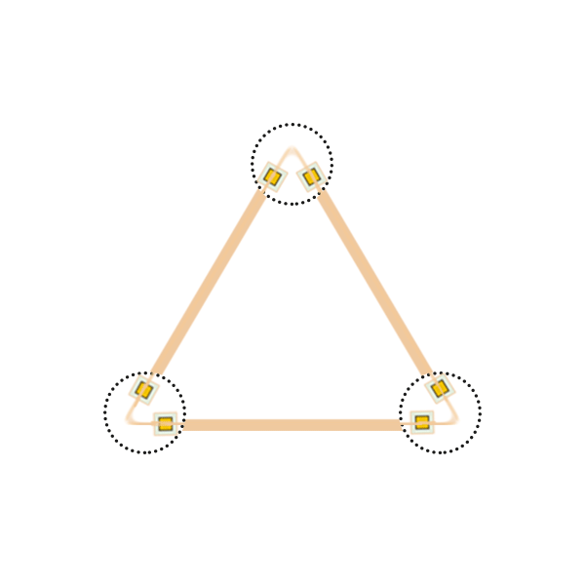
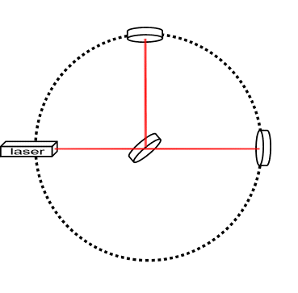
Principle of GW Antenna
Two polarizations:
Shortening in one direction, enlarging in perpendicular direction, and vice versa.
Michelson’s interferometer:
Detecting OPL difference between two perpendicular arms.
Space GW antenna:
Detecting OPL difference between two adjacent arms.

Slide 9
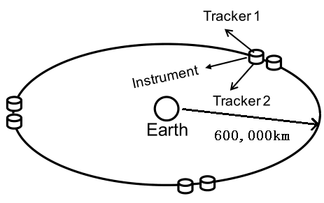
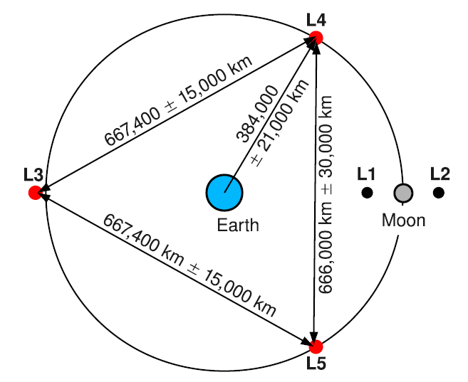
Space GW mission concepts
eLISA/NGO
ASTROD-GW
Solar orbit
Geocentric orbit
LAGRANGE
OMEGA

Slide 10
TianQin Mission Concept
Guidelines：
Develop key technologies by ourselves;
Target specific source, identified by telescopes;
Geocentric orbit, shorter arm-length, higher feasibility;

Slide 11
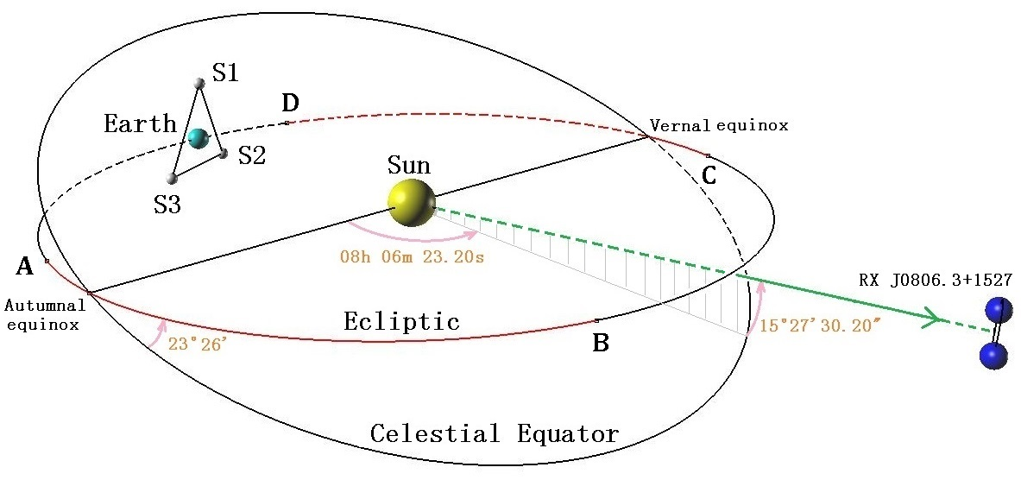
TianQin GW Antenna
Orbit: geocentric orbit with altitude of 100,000km;
Configuration: 3-satellite triangular constellation, nearly vertical to the Ecliptic;
“Calibrated” source: J0806.3+1527, close to the ecliptic;
Detection time window: 3 months;

Slide 12
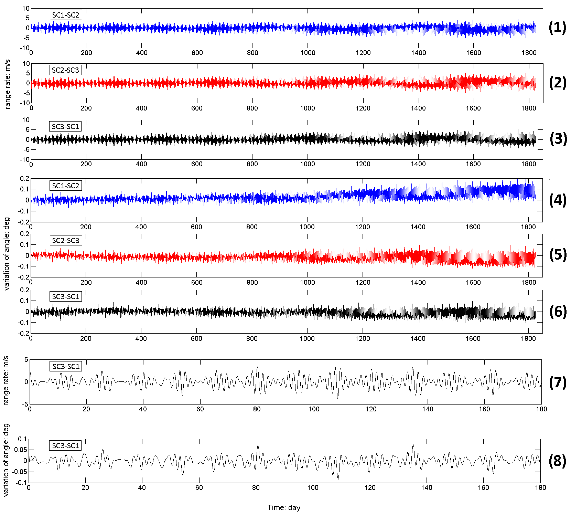
Example of possible orbits (1*10⁵km)
Panels 1,2,3,7 :
Range rate (<10m/s)
Panels
4,5,6,8:
Variation of subtended angles
(Short term <0.1 deg.; Long term
<0.2 deg.)
Panels 7,8:
More detail in first few months.
Notes:
Some of you may know that an orbit vertical to the ecliptic tend to be less stable. So we need to make sure that acceptable orbits do exist.
There are several issues to consider when talking about a real orbit.
The relative velocity between any pair of satellites should be bounded, so that the induced Doppler shift of laser signal can be removed by using on-board oscillators.
The subtended angles of any pair of satellites with respect to the third should also be bounded, so as not to go beyond the capability of pointing control system.
For TianQin, the requirement on subtended angles also constrains the variation of armlengths significantly, and there is no need to take the latter to be an independent factor.
An acceptable set of orbits is shown in the figure.
The relative velocity (range rate) between each pair of satellites varies no more than 10m/s in five years. Its compensation is well within the reach of present technologies.
The variation of subtended angles can be separated into two parts — short term fluctuations and long term shifts in the averaged value of the variation (This is most significant for SC1-SC2 in the figure). The short term fluctuation has periods at the order of a few days and magnitudes at about 0.1◦. This part can be corrected using laser beam pointing control with fast steering mirror. On the other hand, the attitude control of telescope with gimbal mechanism might be needed to deal with the larger variations accumulated through the long term shift. But this can be done at intervals in the order of several months.

Slide 13
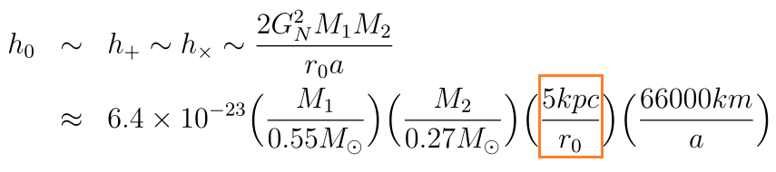
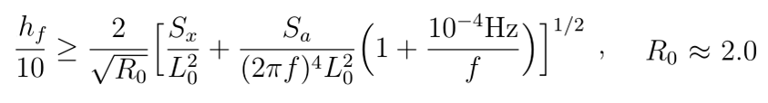
Sensitivity goal
Gravitational wave from RX J0806.3+1527
Masses (0.5, 0.27) Msun
Period 321.5s (distance between stars 66000km)
Distance (0.05 ~ 5) kpc
Strain
Integrated strength (90days)
Relation to noise (SNR=10)
G.H.A.Roelofs et al, ApJ, 711, L138 (2010)
T.E.Strohmayer, ApJ, 627,920(2005)
Simbad data base
: Transfer function
S_x Noise in distance measurement; S_a Noise in acceleration
Notes:
In constructing the TianQin concept, we are in a sense doing a reverse engineering problem. We firstly identify a most accessible source, and then try to derive the requirement on the instruments.
For the example J0806, with its parameters given previously, the magnitude of gravitational wave is at the order 10^-22 to 10^-23. Our goal is to have a decisive detection within a few months (say 90 days), this will correspond to an integrated magnitude 10^-19/Hz^{1/2}.
With our current understanding of the satellite formation of TianQin (This determines the structure of laser interferometer), the expected noise of the instruments can also be estimated. For the present purpose, we only include the two major contributions: the noise from position measurement (laser interferometer) and the residual acceleration (dragfree control).
A signal-to-noise ratio SNR=5 is usually enough for an acceptable detection, but we require SNR=10 for some redundancy. This then impose a constraint on the noise goal on position measurement and on dragfree control.

Slide 14
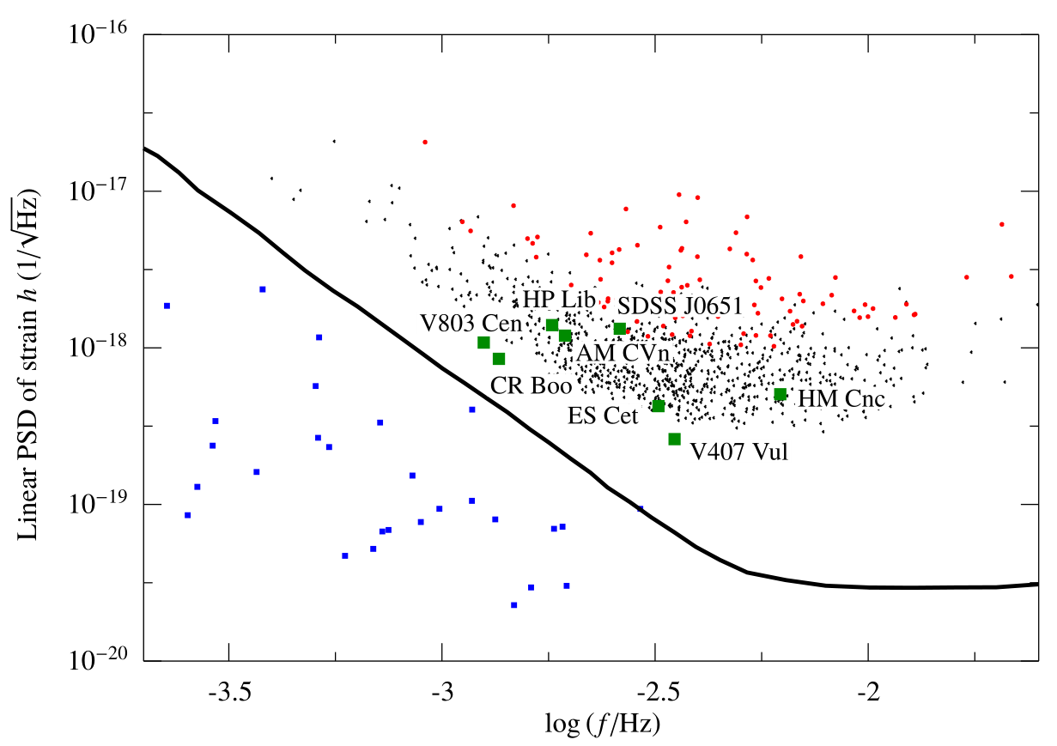
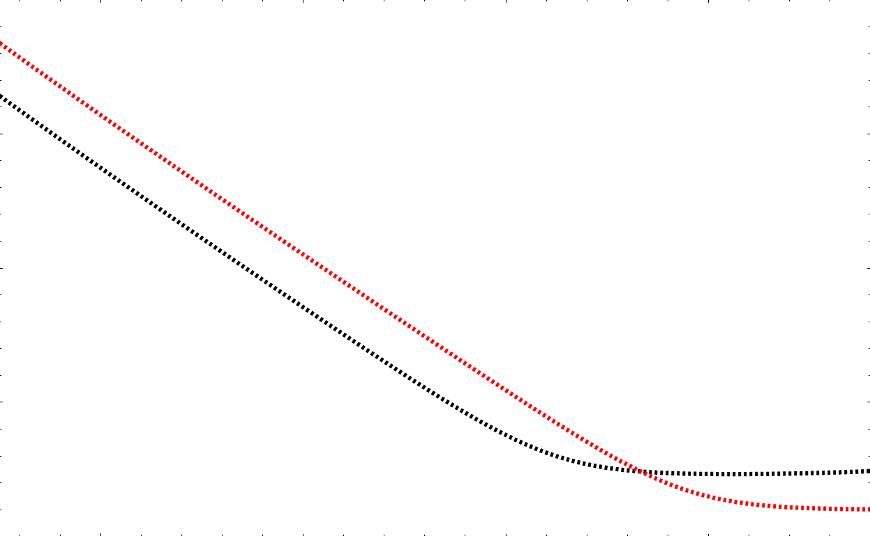
Sensitivity Curve of TianQin
Assuming 2 years of integration time for each source
Black-solid: eLISA
Black-dashed: eLISA (analytical)
Red-dashed: TianQin (analytical)
Green-squares: LVBs
Red-dots: Strongest 100
Black-dots: Strongest 1000
Para. | eLISA | TianQin
Arm Len. | 10⁶ km | 1.7*10⁵ km
Sa^{1/2} | 7*10⁻¹⁵ m/s²/Hz^{1/2} | 3*10⁻¹⁵ m/s²/Hz^{1/2}
Sx^{1/2} | 10.4 pm/Hz^{1/2} | 1 pm/Hz^{1/2}
Pau Amaro-Seoane, et al, GW Notes, Vol. 6, p. 4-110 [arXiv:1201.3621]

Slide 15
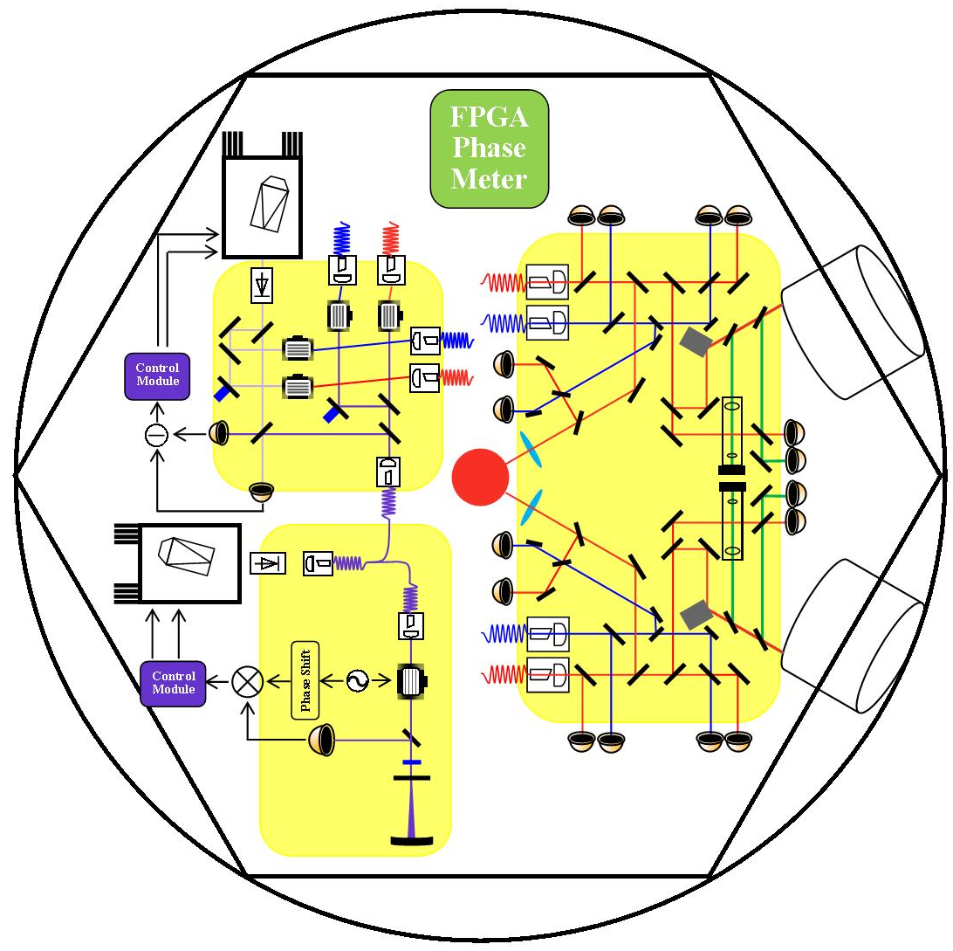
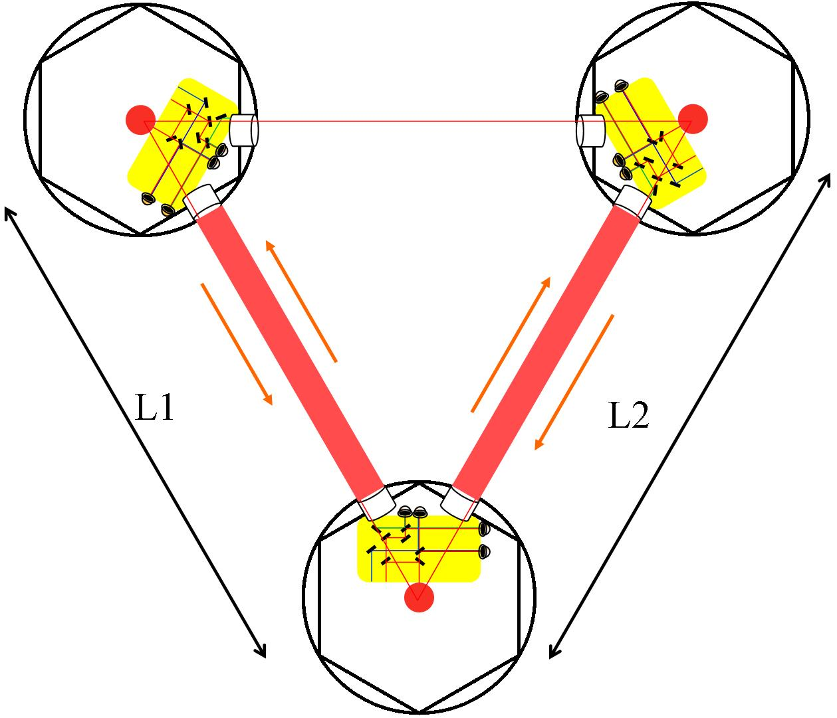
Configuration of Space GW Antenna
Single Satellite
Triangular constellation

Slide 16
Outlines
TianQin mission concept
Key technologies
Development strategy

Slide 17
Requirements
Key Technologies |  | Specifications
Inertial sensing & Drag-free control 10⁻¹⁵ m/s²/Hz^{1/2} | Proof mass | magnetic susceptibility 10⁻⁵ Residual charge 1.7*10⁻¹³C Contact potential 100uV/Hz^{1/2} @ 10mV
 | Cap. Sensor | 1.7*10⁻⁶pF/Hz^{1/2}（3nm/Hz^{1/2}）@ 5mm
 | Temp. stability | 5uK/Hz^{1/2}
 | Residual magnetic field | 2*10⁻⁷T/Hz^{1/2} Satellite remanence 1Am²@0.8m
 | uN-thruster | 100 uN (max); 0.1 uN/Hz^{1/2}
Space Interferometry 1pm/Hz^{1/2} | Nd:YAG Laser | Power 4 W, Freq. noise 0.1 mHz/Hz^{1/2}
 | Telescope | Diameter 20 cm
 | Phasemeter | Resolution 10⁻⁶ rad
 | Pointing control | Offset & jitter 10⁻⁸ rad/Hz^{1/2}
 | Wavefront distortion | λ/10
 | thermal drift of OB | 5nm/K
Notes:
With such requirements, a preliminary error budget has been prepared by our colleagues working on the two specific sectors. These values will need to be improved and verified in the future.

Slide 18
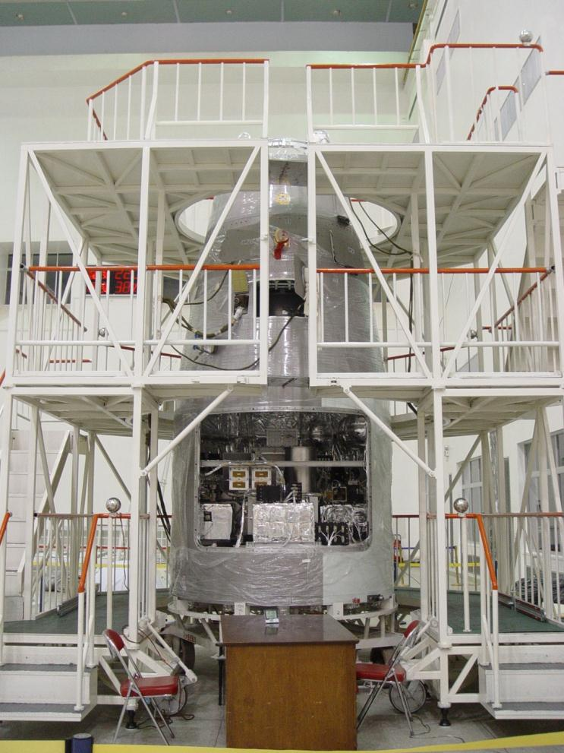
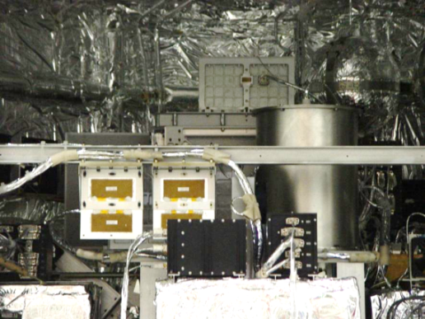
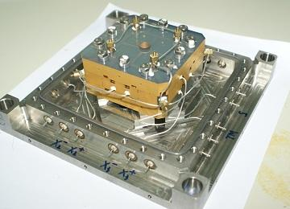
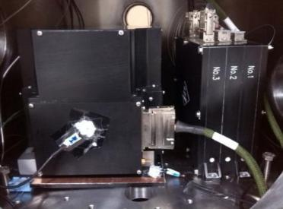
Precision Inertial Sensing
1996-2000: develop flexure-type ACC
2001-2005: space test of flexure-type ACC
— launched in 2006
2006-2010: develop electrostatic ACC
2011-2015: space test of electrostatic ACC
— launched in 2013

Slide 19
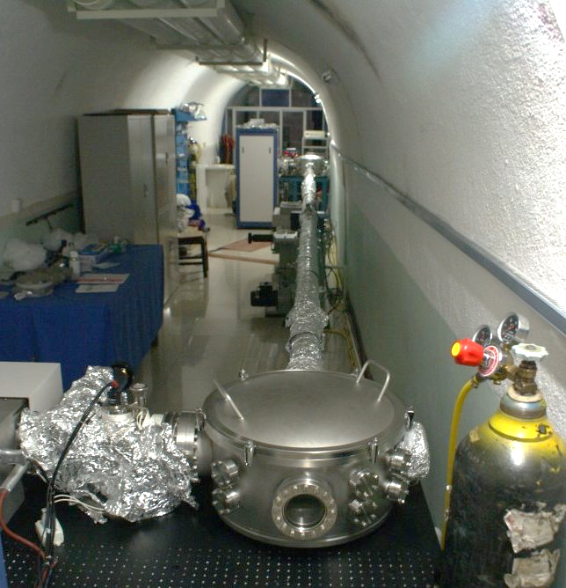
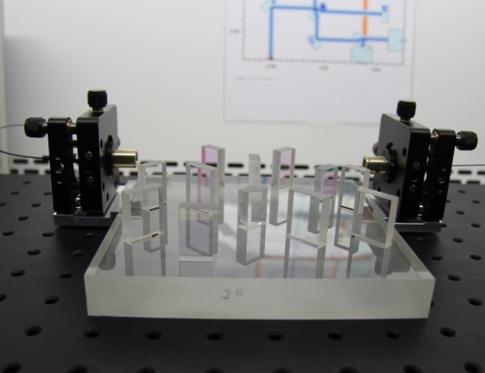
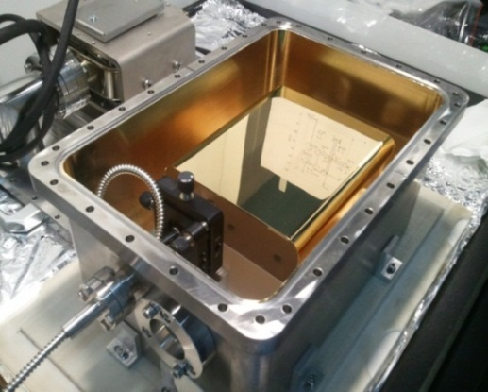
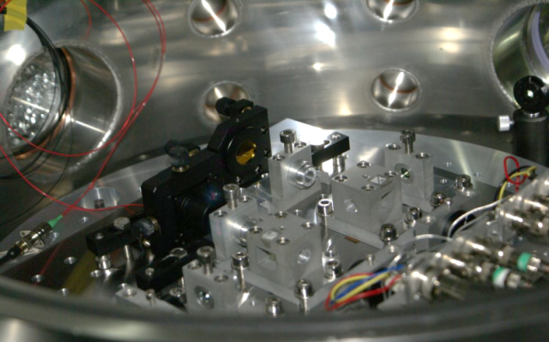
Space Laser Interferometry
2001-2005: nm laser interferometer
2006-2010: (10m) nm laser interferometer
2011-2015: (200km) inter-satellite laser ranging system
Picometer laser interferometer
nW weak light OPLL
nrad pointing angle measurement
10Hz space-qualified laser freq. stab.
Thermal Shield

Slide 20
Key Technologies
Femto-g Drag-free control:
  Ultraprecision inertial sensing: ACC, proof mass
  uN-thruster: continuously adjustable, 5-year lifetime
  Charge management (UV discharge)
Picometer laser interferometry:
  Laser freq. stab.: PDH scheme + TDI
  Ultra-stable OB: thermal drift 1nm/K
  Phase meas. & weal-light OPLL: 10⁻⁶rad，1nW
  Pointing control: 10⁻⁸rad@10⁶km
Ultrastable satellite platform:
  Stable constellation: min. velocity and breathing angle
  Environment control: temperature, magnetic field, gravity and gravity gradient
  Satellite orbiting: position(100m), velocity(0.1mm/s)（VLBI+SLR）

Slide 21
Outlines
TianQin mission concept
Key technologies
Development strategy

Slide 22
Development Strategy
Technology verification for every 5 years;
One mission for each step with concrete science objectives.

Slide 23
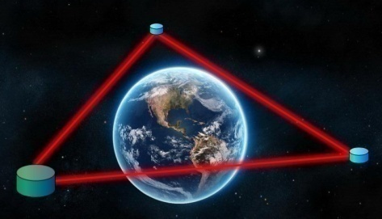
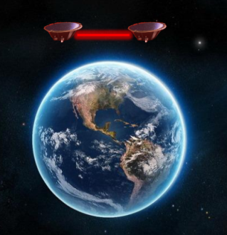
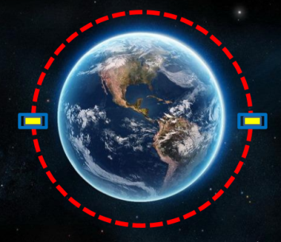
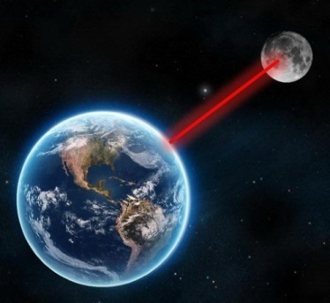
Roadmap
3
2
GW detection
1
0
Global Gravity
Test of E.P.
E.P., 1/r², Ġ, …
Precision satellite formation fly
Picometer space interferometry
Femto-g drag-free control
Intersatellite laser ranging
Precision accelerometer
Inertial sensing
Drag-free control
Laser interferometer
LLR
High-altitude satellite positioning
2016-2020
2021-2030
2031-2035

Slide 24

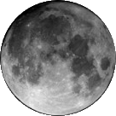
Four Steps to GWD
Step-0:
Lunar laser ranging
2016-2020
Technology objectives
Precision laser ranging to high orbit spacecrafts
Science objectives
Testing fundamental laws in physics
Studying physics of the Earth-Moon system

Slide 25
Four Steps to GWD
Step-1:
Test of equivalence principle in space
2016-2025
Technology objectives
Dragfree 10⁻¹⁰m/s²
Inertial sensor
10⁻¹²m/s²
Micro-thruster 100μN
Spaceborne laser 100Hz
Science objectives
Testing EP to 10⁻¹⁶
J. Jpn. Soc. Microgravity Appl. 25(2008)423-425.

Slide 26
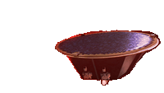
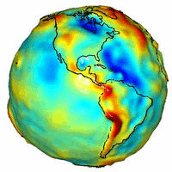
Four Steps to GWD
Step-2:
Next generation gravity satellite
2016-2025
Technology objectives
Inertial sensor
10⁻¹⁰m/s²
10nm@100km
Science objectives
Earth
Global climate change
Rev. Sci. Instrum. 82, 044501 (2011)

Slide 27
Four Steps to GWD
Step-3:
TianQin
2016-2035
Technology objectives
Inertial sensor
10⁻¹⁵m/s²
Dragfree 10⁻¹³m/s²
1pm@10⁷m
μN-thruster
Science objectives
General Relativity
GW astronomy
Class. Quantum Grav. 33, 035010 (2016)

Slide 28
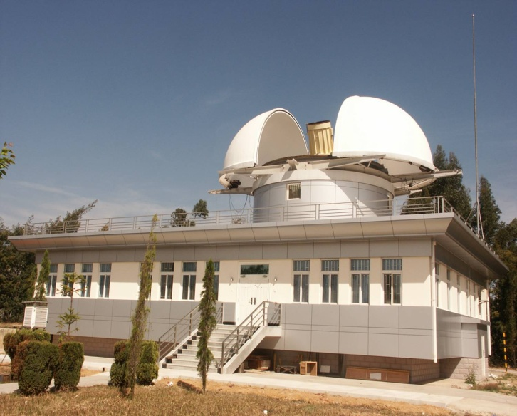
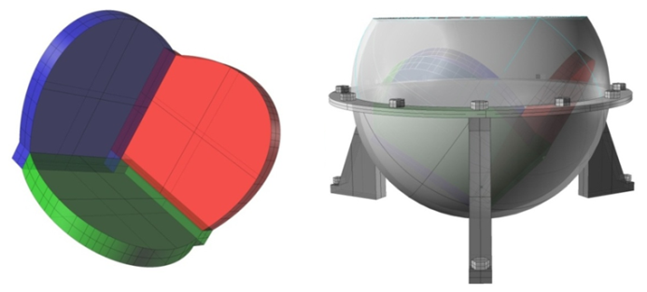
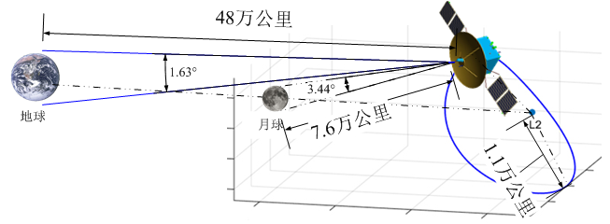
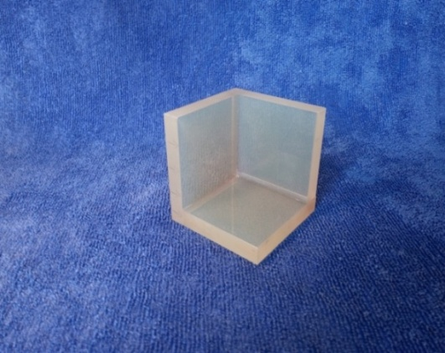
Current Progress
Laser Ranging to CE relay satellite
Creating next-generation laser ranging CCR
Upgrading ground stations
Yunnan station
New-G laser ranging reflectors

Slide 29
Summary
TianQin, aiming at intermediate frequency range, can provide advanced alarms to LIGO & optical telescopes.
TianQin can provide joint GW observations with LIGO and LISA.
TianQin includes a series of space missions, not only to achieve scientific goals but also to verify key technologies step by step.

Slide 30
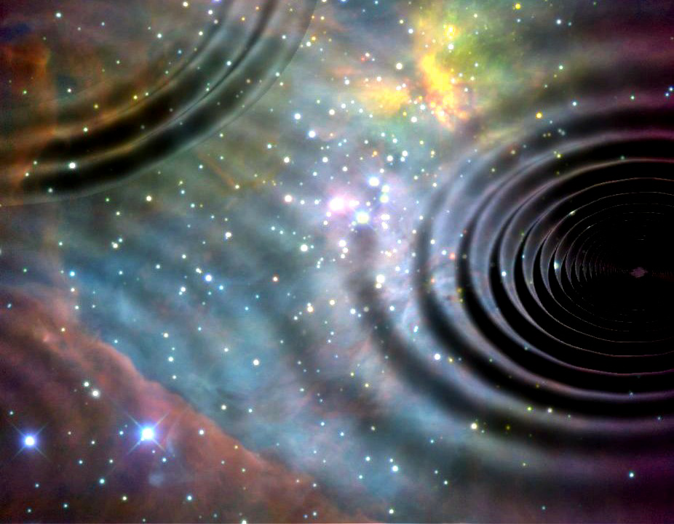
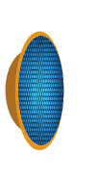


Happy New Year!

